Slide 1


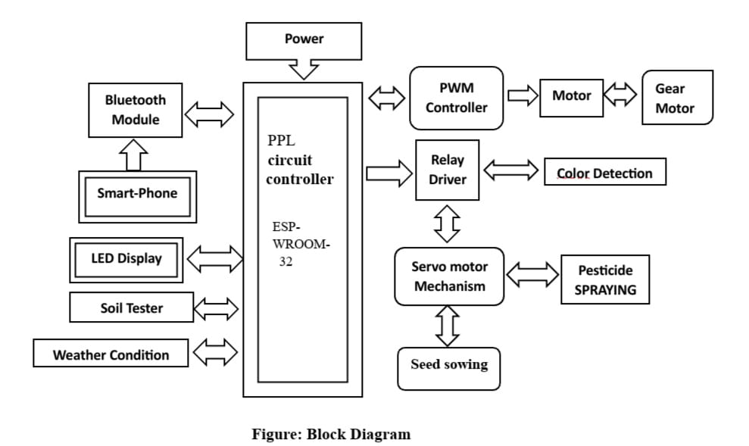
Nagpur Institute of Technology
Department of Electrical Engineering
Project Title:- Multitasking Robot for Agriculture Application
INTRODUCTION
PROBLEM STATEMENTS
Increasing need for automation in agriculture due to labor shortages and rising global population.
Demand for higher productivity and sustainable farming practices is growing rapidly.
Multipurpose agricultural robots offer efficient solutions to modern farming challenges.
Agricultural productivity plays a crucial role in the development of a nation.
Use of proper machinery improves accuracy and quality of agricultural production.
Traditional farming methods (sowing, ploughing, watering, spraying) are time-consuming.
Manual processes are prone to human error and inefficiency.
Agriculture faces challenges such as labor shortages, increasing demand for food, and climate change impacts.
Traditional farming methods are time-consuming, labor-intensive, and less efficient.
Lack of precision in tasks like irrigation, fertilization, and weed control reduces productivity.
There is a need for an automated solution to perform multiple agricultural operations efficiently.
OBJECTIVES
  To design and develop an automated multitasking robotic system for agricultural applications.
  To improve productivity in farming operations using robotics and automation.
METHEDOLOGY
NOVELTY/UNIQENESS OF WORK
Integration of multiple agricultural tasks (monitoring, weeding, fertilizing, harvesting) into a single robotic system.
Use of automation and precision technology
Provides a cost-effective and smart farming.
OBSERVATIONS/RESULTS
  Improved fertilizer and pesticide efficiency by ~30–40% using precision application.
  Decreased water usage by ~25–35% with controlled irrigation methods.Increased overall crop yield by ~15–20% compared to traditional methods.
ADDRESSABLE MARKETS
  Agricultural sector including small, medium, and large-scale farms.
  Smart farming and precision agriculture market with growing adoption of automation.
  Agri-tech startups and research institutions focusing on innovative farming solutions.
  Government and rural development programs promoting modern agricultural technologies.
Fig. 1 Flow of Multi-Tasking Agri-Robot
  It begins with designing a multitasking agricultural robot capable of performing multiple farming operations.
  The robot is equipped with sensors and cameras to monitor crop health, growth, and field conditions.
  It detects and removes weeds to reduce competition for water and nutrients.
  The system applies fertilizers and pesticides in precise quantities based on crop requirements.
IMPACT & BENIFITS
HARDWARE MODEL
  Improves agricultural productivity and efficiency through automation.
  Reduces labor dependency and operational costs.
  Ensures precision farming, minimizing wastage of water, fertilizers, and pesticides.
  Supports sustainable and eco-friendly agriculture practices.
  Enhances crop quality and overall yield.
Name of the students
Project Guide
Prof. Amit M. Dodke
Project Co-Guide
Prof. Rahul Argelwar
Puja G. Pandhram Pallavi F . Janbandhu | 3. Greny P . Chaudhary 4. Pritee M. Tilgame

